Slide 1

Alzheimer's Diagnosis
Jacky Irwin
Tessa Price
Taryn Rahman

Slide 2
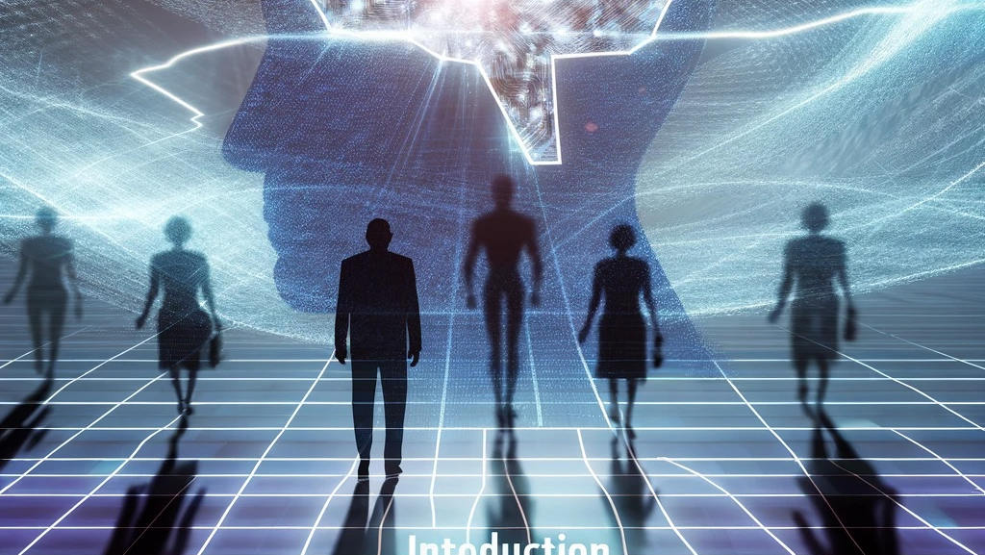
Introduction

Slide 3
Overview and impact
Lead cause of dementia
Severely impacts daily living
Heavy burden placed on families
Complications
Increased mortality
Invasive procedures to obtain diagnosis

Slide 4
Urgency of early detection
Developing models
DARWIN Handwriting Dataset
Alzheimer's MRI Dataset

Slide 5

Goals
Improve quality of life
Seek advancement in options
Determine best options

Slide 6
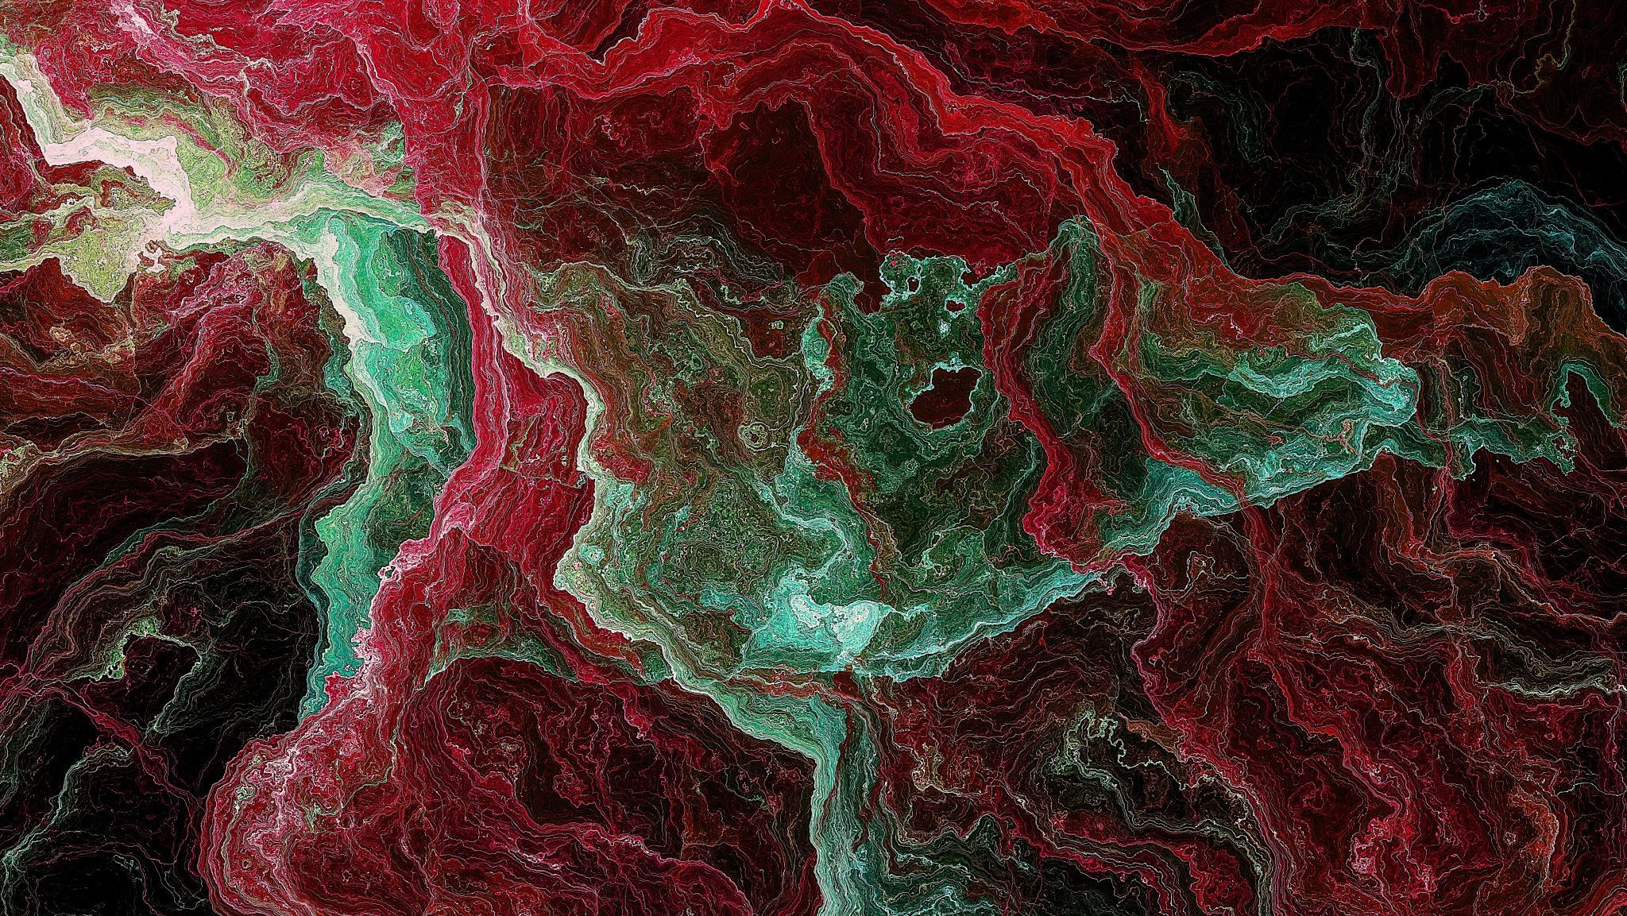
Background

Slide 7
Models used before
Convolutional Neural Network
Support Vector Machines
K-nearest neighbors
DenseNet-169
ResNet-50
Random Forest Algorithm
Multilayer Perceptron

Slide 8
previous findings
Deep learning scores outperformed traditional predictive models
SVM great classifier for speech
CNN proficient in analyzing disfluency
DenseNet-169 more effective in real-time classification
Random Forest highly accurate in complex data

Slide 9
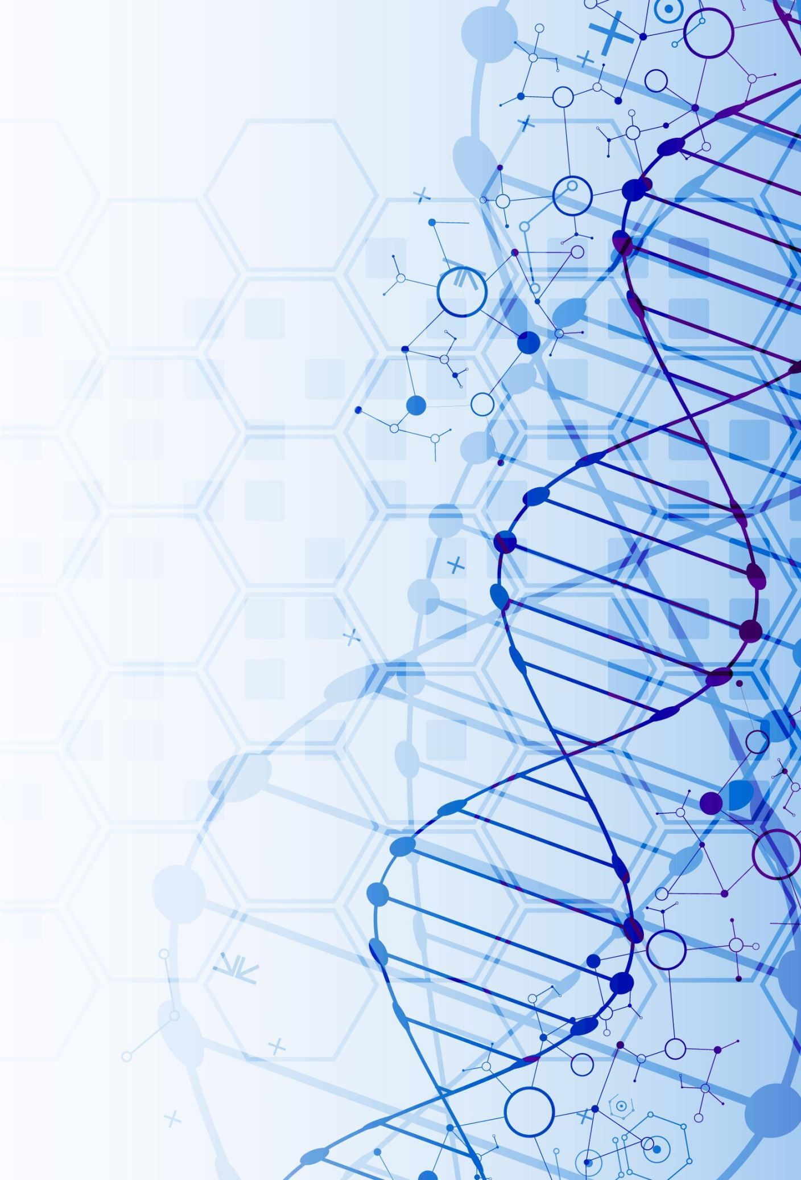
Methodology/Results

Slide 10
Models we used
Darwin
PCA
Random Forest
SVM
MRI
Random Forest
Feed forward
DL
GRU
Feed forward
ML
ML
CNN
KNN
SMOTE
DL

Slide 11
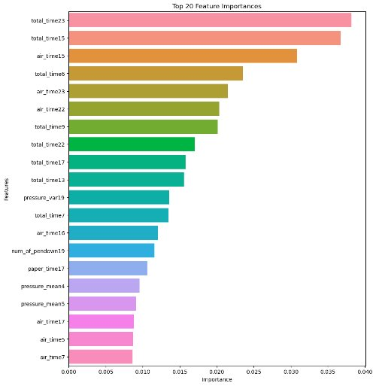
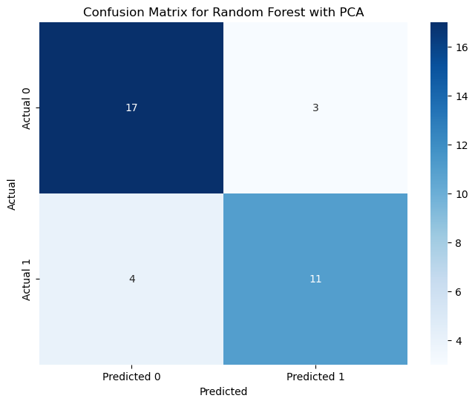
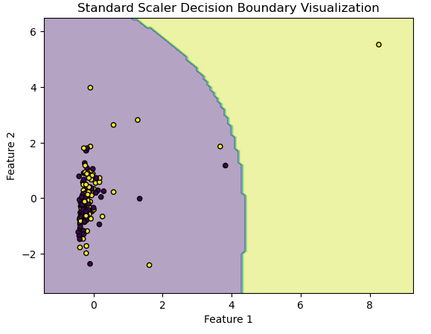
DaRWIN ML
SVM
Utilized to classify
PCA
Dimensionality reduction
StandardScaler and MinMax Scaler
Best with SVM
Notes:
A Support Vector Machine (SVM) model was utilized to classify the handwriting data. Using PCA for dimensionality reduction and experimenting with StandardScaler and MinMaxScaler. Both StandardScaler and MinMaxScaler performed the best with the polynomial kernel for SVM with an accuracy of 80. Although, after plotting the decision boundaries it was discovered there may be an error with the classification.

Slide 12
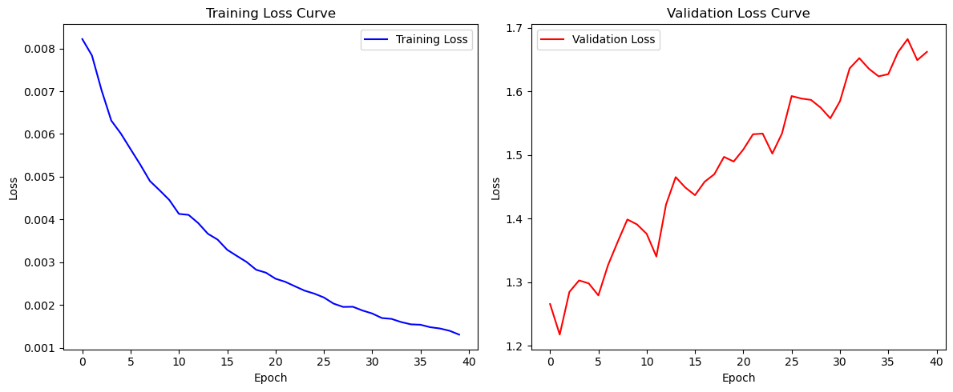
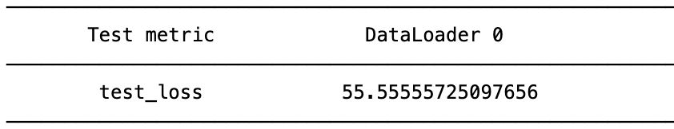
DARWIN DL
LEFT: GRU LOSS
Right: FULL CONNECTED FORWARD FEED

Slide 13
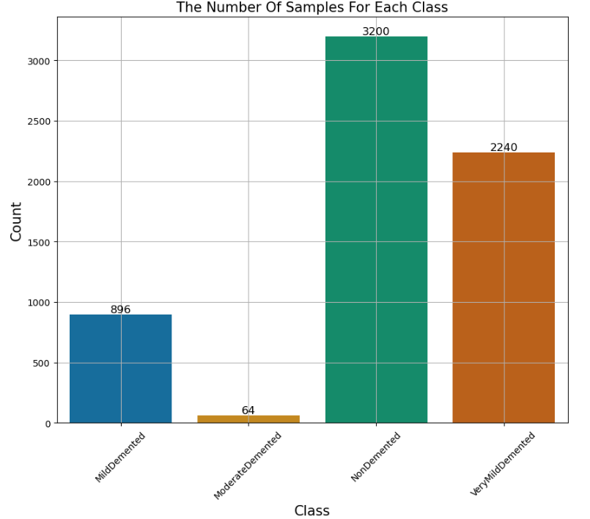
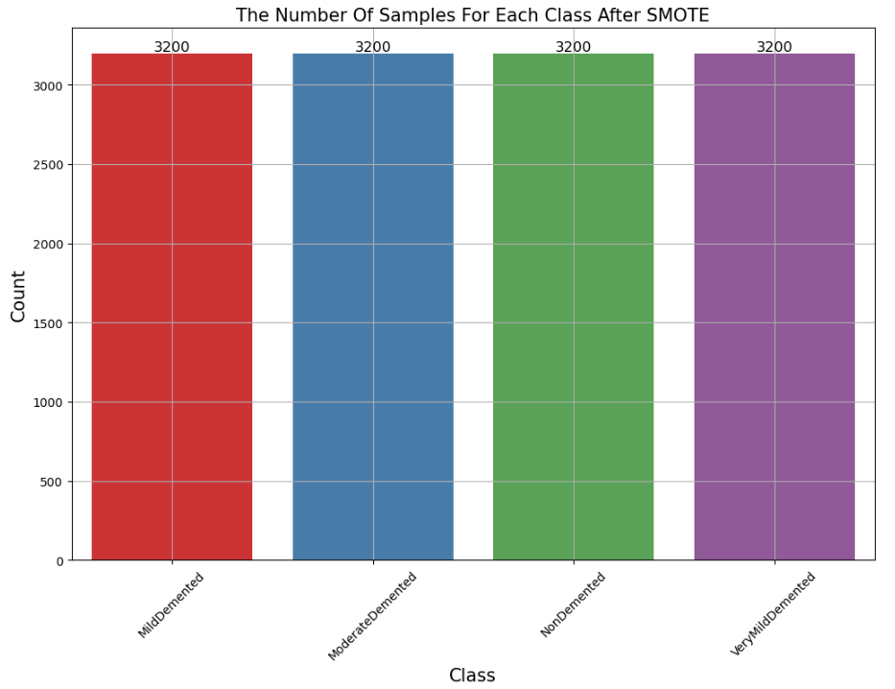
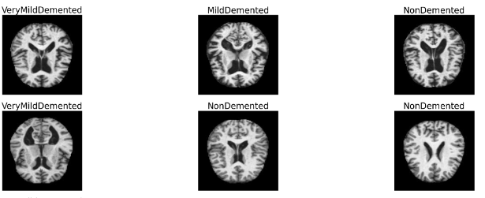
MRI ML
SMOTE
Used for Oversampling
Random Forest
Classification accuracy 75%
Hyperparameter tuning accuracy 76%
Max depth: 20 , minimum samples split: , number estimators: 100
KNN
Classification accuracy 94%
Hyperparameter tuning accuracy 94%
Notes:
ML
Random Forest
KNN
SMOTE

Slide 14
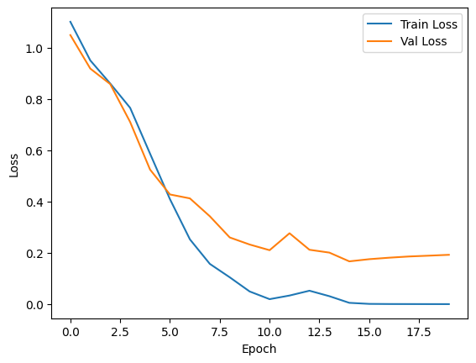
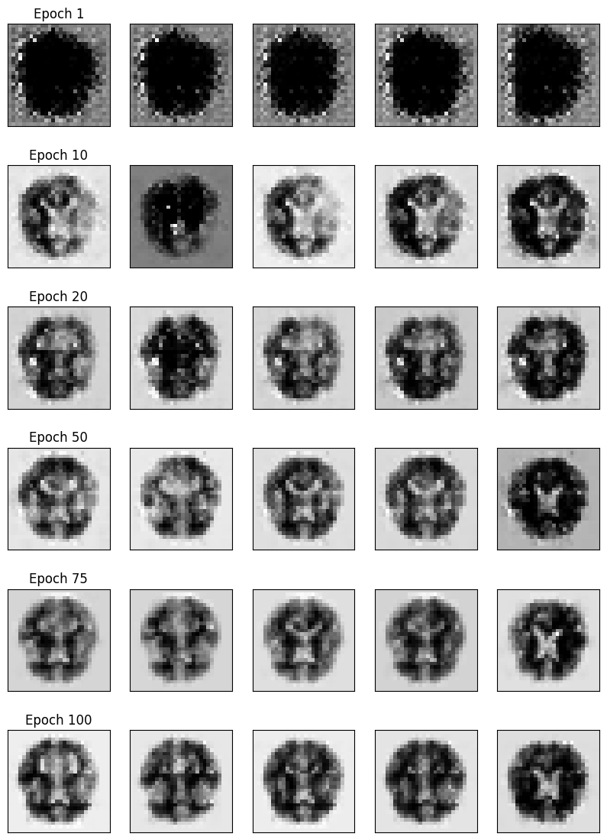
MRI DL
LEFT: CNN Loss
Right: GAN

Slide 15

discussion

Slide 16
MRI Vs. DARWIN
ML models:
Random Forest
Darwin
Highest score
K-nearest
MRI
Nearly 5% increase in accuracy
DL models:
More success in producing models for the DARWIN dataset over MRI
Notes:
ML models:
Tend to have higher accuracy with the DARWIN data with random forest
Using K-nearest Neighbor had a high accuracy with MRI data exceeding the accuracy scores of the other models used on DARWIN
DL models:

Slide 17
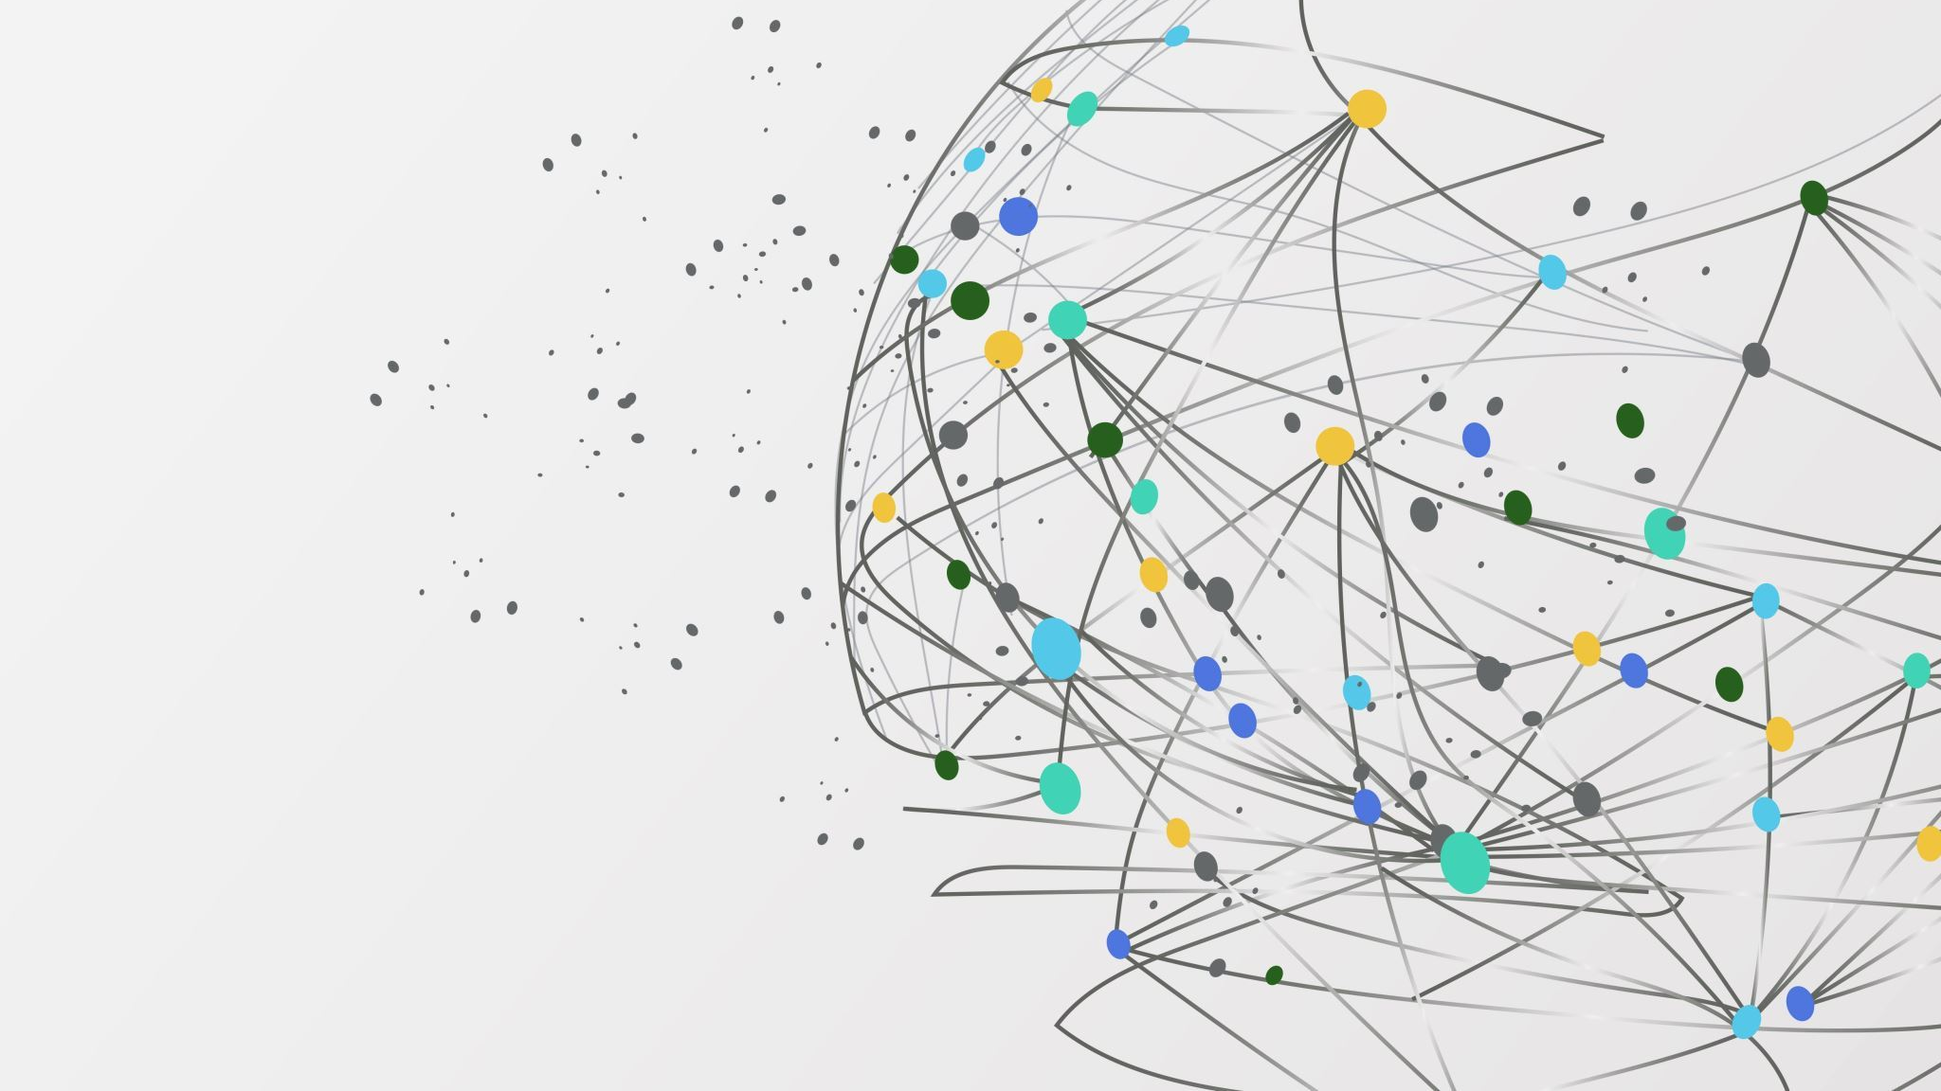
Conclusion

Slide 18
ML models tended to have a greater accuracy when it came to the MRI data in comparison to DARWIN data, though producing DL models were challenging with the MRI data
The DARWIN data tended to be easier to build models for to produce higher accuracy sooner.
Both methods of detection seem to be viable options, though to build models for MRI data it will require a greater amount of optimization of the models to produce higher level of accuracy comparable to those for DARWIN data.

Slide 19
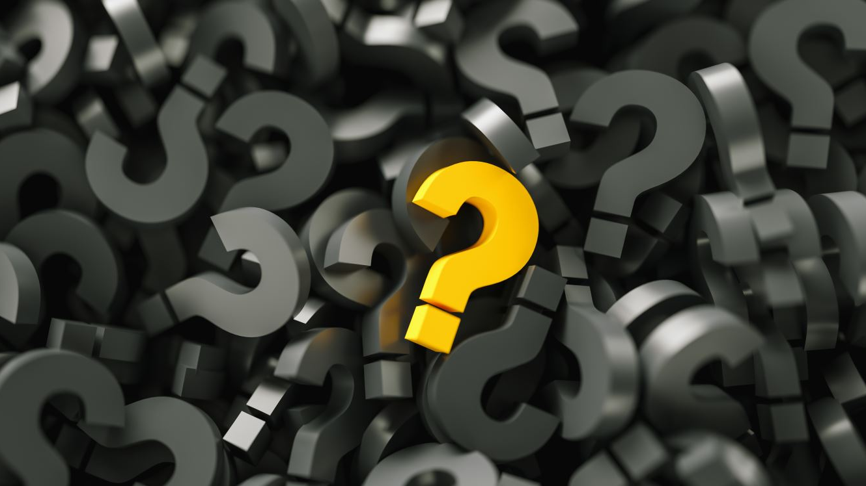
Questions

